Slide 1
CAPSTONE PROJECT
FANDANGO MOVIE RATING DESCRIPTION ANALYSIS
Presented By:
HOMAARTHINI N
Arunai Engineering College
Btech Biotechnology

Slide 2
OUTLINE
Problem Statement
Proposed System/Solution
System Development Approach
Algorithm & Deployment
Result
Conclusion
Future Scope
References

Slide 3
PROBLEM STATEMENT
Users face difficulty discerning the authenticity and accuracy of movie ratings due to various factors such as fake reviews, biased ratings, and manipulation of rating systems. This leads to skepticism and uncertainty regarding the true quality of movies.
Current recommendation systems often lack personalization, providing generic suggestions based on limited criteria such as genre or popularity. This results in suboptimal movie-watching experiences as users struggle to find content aligned with their unique preferences and tastes.

Slide 4
PROPOSED SOLUTION
Implement robust algorithms to detect and filter out fake or manipulated ratings.
Utilize cross-platform comparison and data integrity checks to ensure rating authenticity.
Introduce user feedback mechanisms to report suspicious ratings and enhance transparency.
Develop advanced user profiling techniques based on historical ratings, viewing history, and explicit user preferences.
Utilize collaborative filtering, content-based filtering, and hybrid approaches to provide personalized movie recommendations.
Incorporate context-aware recommendation strategies to account for diverse user preferences and viewing contexts.

Slide 5
SYSTEM APPROACH
System Requirement
Hardware :
High-performance servers to handle data processing, analysis, and storage.
Multi-core processors (e.g., Intel Xeon) for parallel processing of large datasets.
Sufficient RAM (Random Access Memory) to accommodate data processing and analysis tasks efficiently.
Software :
Server-grade operating systems such as Linux (e.g., Ubuntu Server, CentOS) or Windows Server for hosting the movie rating analysis system.
Client devices may use various operating systems (e.g., Windows, macOS, Linux, Android, iOS) to access the system through web interfaces or applications.
Relational Database Management System (RDBMS) such as MySQL, PostgreSQL, or MariaDB for storing structured movie data.

Slide 6
SYSTEM APPROACH
Library Requirement :
Data Collection and Processing:
Pandas: For data manipulation and analysis, such as cleaning and organizing collected movie data.
NumPy: For numerical computing tasks that may arise during data preprocessing.
Rating Verification and Authenticity:
Scikit-learn: For implementing machine learning models for detecting fake or manipulated ratings.
NLTK (Natural Language Toolkit): For text processing and sentiment analysis to identify biased or misleading reviews.
Matplotlib or Seaborn: For visualizing patterns and anomalies in rating data

Slide 7
ALGORITHM & DEPLOYMENT
Algorithm Selection :
Data Availability:
Consider the availability and quality of data (e.g., user-item interactions, item features) when selecting algorithms.
System Requirements:
Assess computational resources, scalability, and real-time performance requirements of the system.
User Experience:
Choose algorithms that provide personalized and diverse recommendations to enhance the user experience.
Evaluation Metrics:
Select algorithms based on performance metrics such as accuracy, coverage, and novelty.
Integration:
Ensure seamless integration with other system components such as data pipelines, user interfaces, and feedback mechanisms.

Slide 8
ALGORITHM & DEPLOYMENT
Data Input
Data Collection:
The system starts by collecting movie data from various sources such as APIs (e.g., IMDb, TMDB) and web scraping techniques.
Data collection involves retrieving information such as movie titles, ratings, reviews, genres, cast, crew, release dates, and box office performance.
Data Preprocessing:
The collected data undergoes preprocessing to clean and organize it for further analysis.
Preprocessing tasks may include removing duplicate entries, handling missing values, standardizing data formats, and resolving inconsistencies.
Data Integration:
Once preprocessed, the data from different sources is integrated into a unified dataset.
Integration involves merging, joining, or combining data from various sources based on common identifiers such as movie titles or IDs.

Slide 9
ALGORITHM & DEPLOYMENT
4. Data Storage:
The integrated dataset is stored in a database management system (DBMS) for efficient storage and retrieval.
The DBMS may be relational (e.g., MySQL, PostgreSQL) or NoSQL (e.g., MongoDB, Cassandra) depending on the nature of the data and querying requirements.
Training process
Model Training:
Split the dataset into training and validation sets to train and evaluate the model's performance.
Train the selected algorithm on the training dataset using appropriate training techniques .
Evaluation:
Evaluate the trained model's performance on the validation dataset using suitable evaluation metrics .
Compare the performance of different models and algorithms to select the best-performing one for movie rating analysis.

Slide 10
ALGORITHM & DEPLOYMENT
Model Deployment:
Once the model is trained and evaluated, deploy it into production to make predictions on new data.
Integrate the trained model into the movie rating analysis system's architecture, ensuring scalability, efficiency, and real-time performance
Prediction process:
Data Preparation:
Ensure that the input data for prediction includes relevant information about users and movies. This may include user preferences, movie features (e.g., genre, cast, director), and historical user interactions (e.g., ratings, watch history).
User and Movie Representation:
Represent users and movies in a suitable format that can be fed into the prediction model. This may involve encoding categorical features, scaling numerical features, or creating user-item interaction matrices.

Slide 11
ALGORITHM & DEPLOYMENT
Model Selection:
Choose the appropriate prediction model based on the nature of the problem and available data. Commonly used models for movie rating analysis include collaborative filtering, content-based filtering, matrix factorization, and deep learning models.
Model Prediction:
Use the trained prediction model to make predictions or recommendations for users and movies.
For collaborative filtering models, predict movie ratings based on similarities between users or items in the dataset.

Slide 12
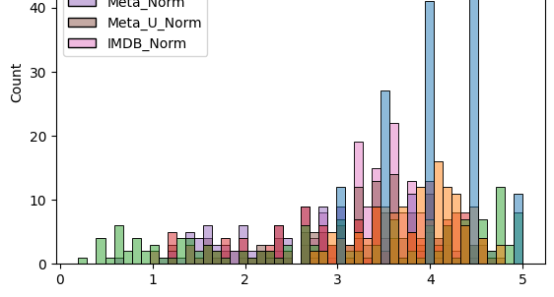
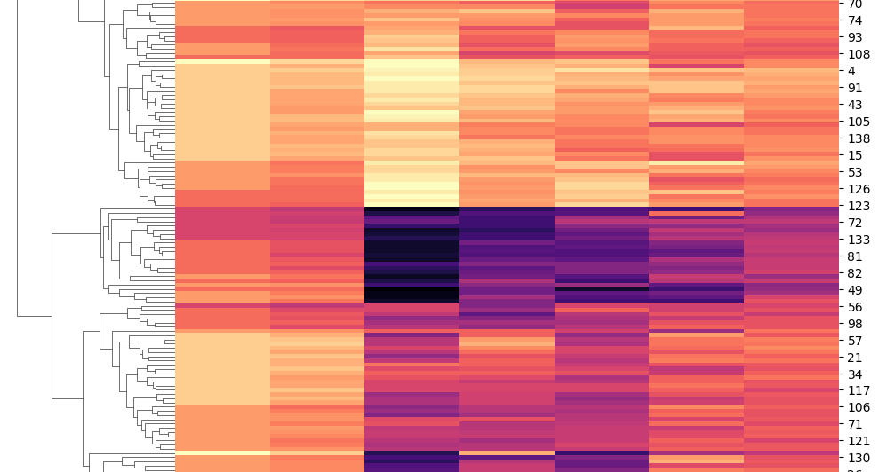
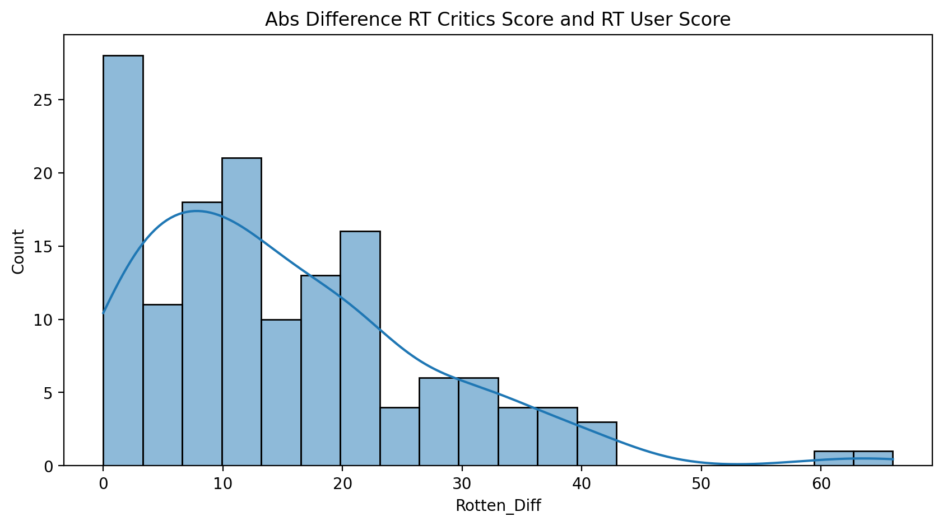
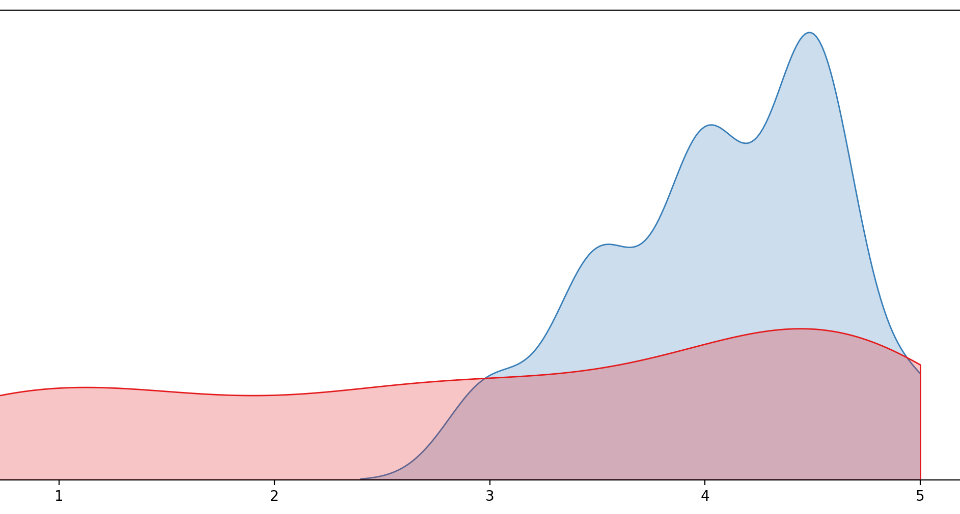
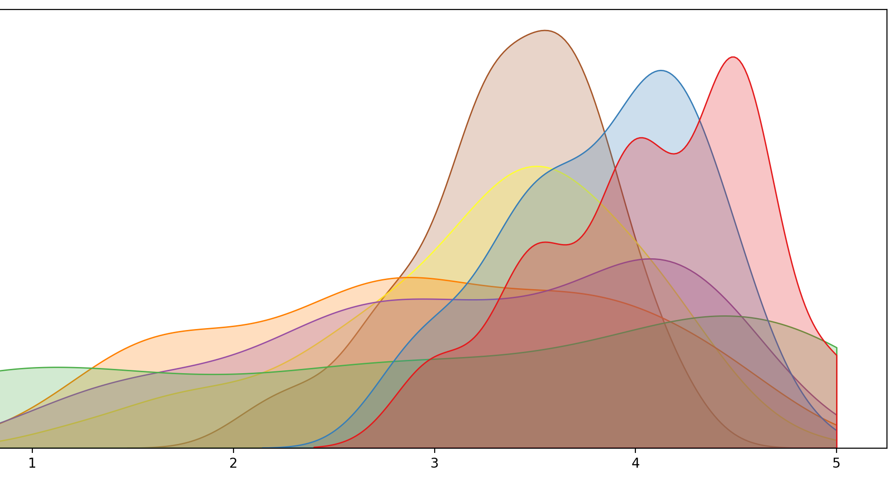
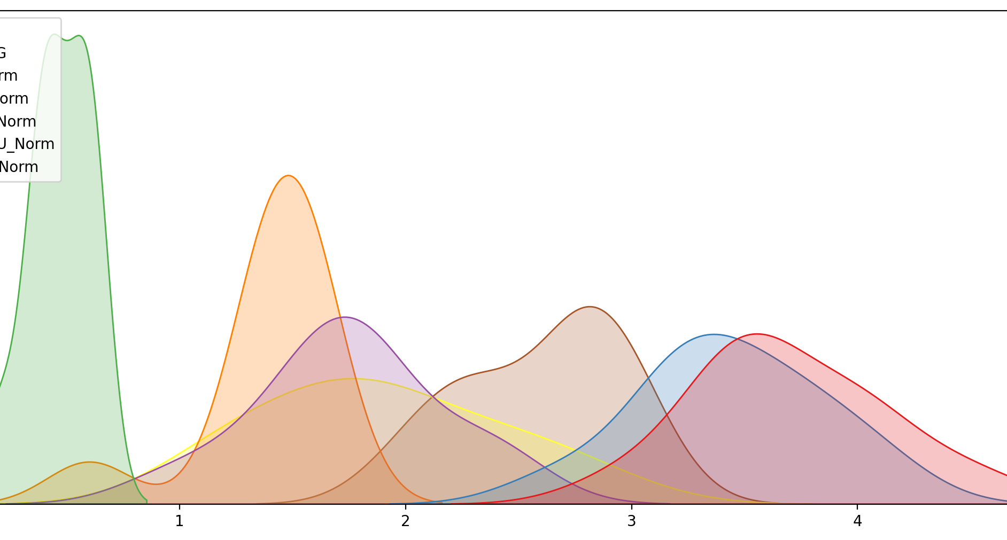
RESULT

Slide 13
CONCLUSION
In conclusion, movie rating analysis plays a pivotal role in enhancing the movie-watching experience by providing users with personalized recommendations and valuable insights into movie preferences. Through the utilization of advanced algorithms, data processing techniques, and real-time analytics, movie rating analysis systems have the potential to revolutionize how users discover, explore, and engage with movies.

Slide 14
FUTURE SCOPE
Augmented Reality (AR) and Virtual Reality (VR):
Exploring AR and VR technologies to create immersive movie discovery experiences, allowing users to explore virtual movie theaters, watch trailers, and interact with movie posters in real-time.
Implementing AR-powered recommendation systems that overlay movie recommendations onto real-world environments based on user preferences and context.
Predictive Analytics:
Harnessing predictive analytics techniques to anticipate user preferences and behavior, enabling proactive recommendation strategies that anticipate users' movie interests before they express them explicitly.
Integrating predictive models with streaming platforms to personalize content recommendations in real-time as users navigate through their movie-watching journey.
Interactive User Interfaces:
Developing interactive user interfaces that allow users to provide instant feedback on recommended movies, enabling the system to adapt recommendations in real-time based on user reactions and preferences.
Integrating chatbots or virtual assistants to engage with users in real-time, offering personalized recommendations, answering queries, and providing movie-related insights.

Slide 15
REFERENCES
http://www.kaggle.com/datasets
http://pandas.pydata.org/pandas-docs/stable/user_guide/index.html
http://seaborn.pydata.org/
http://matplotlib.org/stable/contents.html

Slide 16
THANK YOU

